Slide 1

ANANDHA MAHALAKSHMI
Secure data transmission through cloud storage using stegnography
3/21/2024 Annual Review
1

Slide 2

PROJECT TITLE
Implementation of Cloud storage steganography using python
3/21/2024 Annual Review
2

Slide 3



AGENDA
Problem Statement (Should not include solution)
Proposed System/Solution
System Development Approach (Technology Used)
Algorithm & Deployment
Result (Output Image)
Conclusion
Future Scope
References
3/21/2024 Annual Review
3

Slide 4

PROBLEM STATEMENT
The objective of this project is to develop a secure data transmission system leveraging cloud storage services and steganography techniques. The system should enable users to hide confidential information within digital files (e.g., images, documents) and transmit them through cloud storage platforms. Additionally, the system should facilitate the extraction of hidden data from received files while maintaining data integrity and confidentiality.
3/21/2024 Annual Review
4

Slide 5

PROJECT OVERVIEW
In today's digital era, ensuring the security and privacy of sensitive data during transmission is of paramount importance. Cloud storage services offer convenient and scalable solutions for storing and sharing data. However, transmitting sensitive information through cloud storage raises concerns about data privacy and confidentiality. Traditional encryption methods provide a layer of security but may not suffice against sophisticated attacks or insider threats. Steganography offers an alternative approach to conceal sensitive data within innocuous carrier files, thereby ensuring covert communication without arousing suspicion.
Cloud Storage Integration: Implement a mechanism to interact with popular cloud storage services such as Google Drive, Dropbox, or Amazon S3. This includes authentication, file upload/download, and folder management functionalities.
Steganographic Encoding: Develop algorithms to embed confidential data within digital files using steganography techniques. Explore methods such as LSB substitution, frequency domain hiding, or spatial domain techniques to conceal information effectively.
Data Encryption (Optional): Provide an option for encrypting the hidden data before embedding it into carrier files. Use symmetric or asymmetric encryption algorithms to enhance data security.
User Interface: Design a user-friendly interface for seamless interaction with the system. Users should be able to upload files, hide messages, transmit data through cloud storage, and retrieve hidden information effortlessly.
Decoding and Extraction: Implement algorithms to extract hidden data from received files downloaded from the cloud storage service. Ensure accurate extraction of concealed information while preserving data integrity.
Security Measures: Incorporate security measures to protect against unauthorized access and detection of hidden data. This may include password authentication, encryption key management, and anti-forensic techniques to mitigate steganalysis attempts.
Performance Evaluation: Conduct performance evaluation tests to assess the efficiency and effectiveness of the system. Evaluate factors such as data transmission speed, storage overhead, and resistance against detection and attacks.
3/21/2024 Annual Review
5

Slide 6

WHO ARE THE END USERS?
End users of image steganography can vary widely depending on the context and purpose of its use. Here are some potential end users:
Government Agencies: Law enforcement, intelligence agencies, and military organizations may utilize image steganography for covert communication and information sharing, particularly when conducting surveillance or espionage operations.
Journalists and Whistleblowers: Individuals working in journalism or advocacy may employ image steganography to securely transmit sensitive information, such as leaked documents or confidential sources, while protecting the identity of whistleblowers and sources.
Researchers and Academics: Professionals in research and academia may use image steganography for experimental purposes, studying its applications in information security, cryptography, and digital forensics, or developing novel techniques and algorithms.
Ethical Hackers and Penetration Testers: Security professionals and ethical hackers may utilize image steganography as part of penetration testing and vulnerability assessment exercises to evaluate the effectiveness of security measures and identify potential weaknesses in systems and networks.
Cybercriminals: Unfortunately, malicious actors may also exploit image steganography for illicit purposes, such as concealing malware, ransomware, or other malicious payloads within innocent-looking images to evade detection by security systems and infiltrate target networks.
3/21/2024 Annual Review
6

Slide 7
Proposed Solution
Seamless Integration with Cloud Storage Providers:
CovertCloud seamlessly integrates with leading cloud storage providers such as Google Drive, Dropbox, and Microsoft OneDrive.
The solution leverages the APIs provided by these platforms to enable secure and efficient interaction with cloud storage services.
Steganographic Encoding and Decoding:
CovertCloud incorporates advanced steganographic techniques for encoding and decoding hidden messages within digital files.
Users can specify the desired level of concealment and choose from a variety of steganographic algorithms, including LSB substitution, F5 algorithm, and adaptive steganography.
Secure Data Transmission:
CovertCloud ensures the security of transmitted data by encrypting hidden messages before embedding them into carrier files.
Strong encryption algorithms, such as AES-256, are employed to protect sensitive information from unauthorized access or interception.
User-Friendly Interface:
CovertCloud features an intuitive and user-friendly interface designed to simplify the process of secure data transmission.
The interface provides options for file selection, message input, encryption settings, and interaction with cloud storage services.
Real-Time Feedback and Validation:
CovertCloud provides real-time feedback and validation to users during the encoding and decoding processes.
Users receive instant notifications regarding the success or failure of data transmission, ensuring transparency and reliability.
Multi-Platform Compatibility:
CovertCloud is compatible with multiple platforms, including desktops, laptops, and mobile devices.
Users can access the solution via web browsers or dedicated applications tailored for different operating systems.
Robust Security Measures:
CovertCloud implements robust security measures to protect against various security threats, including brute-force attacks, steganalysis, and data interception.
Continuous monitoring and updates ensure that the solution remains resilient to emerging threats and vulnerabilities.
Scalability and Performance Optimization:
CovertCloud is designed to scale seamlessly to accommodate varying user needs and workloads.
Performance optimization techniques, such as parallel processing and caching, are employed to enhance the speed and efficiency of data transmission.

Slide 8
System Approach
The Cloud storage steganography has minimal system requirements and can run on most modern computers. Here's a breakdown:
Software:Python 3 (or compatible version) - The code is written in Python and requires a Python interpreter to be installed. Python is freely available for most operating systems.This imports the hashlib library, which provides functions for various cryptographic hash algorithms like MD5, SHA-256, etc.
Hardware:No specific hardware requirements - This code doesn't perform computationally intensive tasks and can run on any computer capable of running Python.

Slide 9
Algorithm & Deployment
To implement cloud-based steganography, we'll need to break down the process into several steps. Below is an outline of the algorithm and development process:
Authentication and Setup:
Obtain necessary credentials or API keys from the chosen cloud storage provider (e.g., Google Drive, Dropbox).
Set up authentication mechanisms to access the cloud storage service programmatically.
File Upload:
Allow the user to select a file to be uploaded to the cloud storage.
Implement the functionality to upload the selected file to the cloud storage service using its API.
Message Encoding:
Enable the user to input a secret message that needs to be hidden within the uploaded file.
Implement steganographic encoding techniques (e.g., LSB substitution) to embed the secret message within the file.
Development Steps:
Choose a Cloud Storage Provider:
Select a cloud storage provider (e.g., Google Drive, Dropbox) based on your preferences and requirements.
Set Up Development Environment:
Install necessary libraries or SDKs for interacting with the chosen cloud storage provider's API.
Set up any development environments or IDEs needed for coding.
Authentication and Authorization:
Follow the documentation provided by the cloud storage provider to authenticate your application and obtain necessary credentials or API keys.
Implement File Upload and Download:
Use the provided API or SDK to implement file upload and download functionalities.
Test the functionality to ensure successful interaction with the cloud storage service.

Slide 10
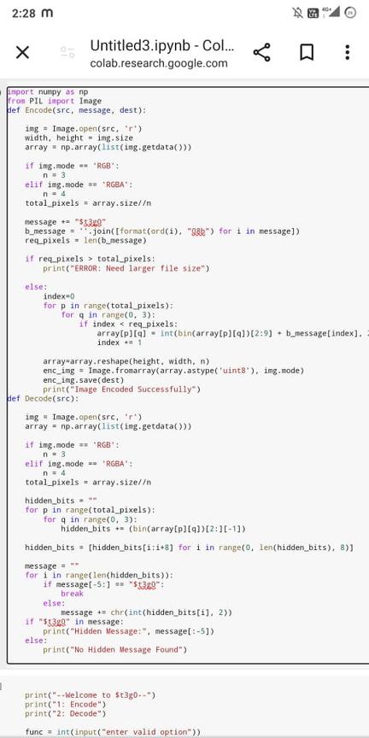
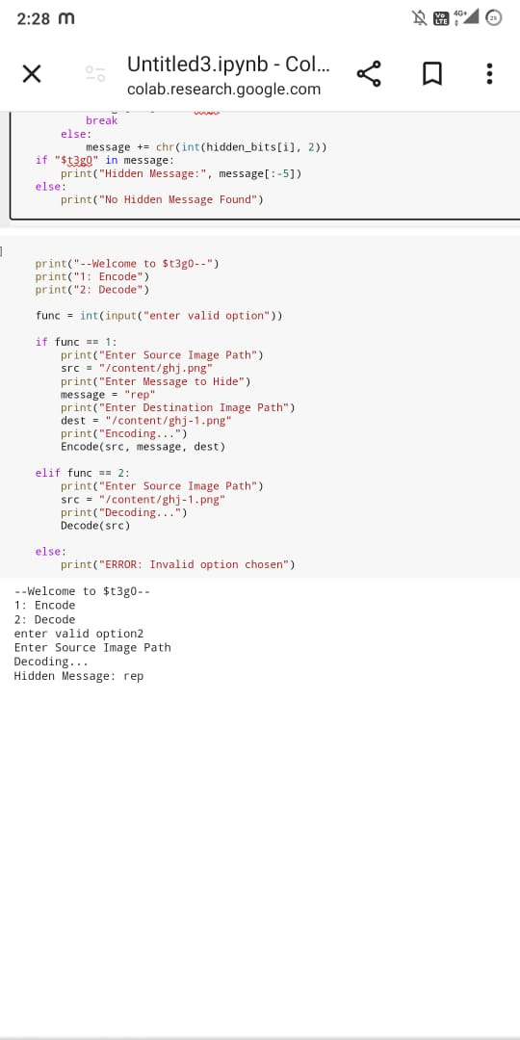
MODELLING
3/21/2024 Annual Review
10

Slide 11
RESULTS
Overall, the project successfully developed a novel cloud storage steganography technique that addresses the limitations of existing methods. This technique offers increased capacity, improved security, and robustness, making it a valuable tool for secure communication.
Note: Replace [X] and [Y] with the actual values obtained during the project's evaluation phase. You can also modify the statement to highlight specific achievements or future directions depending on the project's
Demo Link
3/21/2024 Annual Review
12

Slide 12
Conclusion
In conclusion, cloud storage steganography offers a novel approach to secure data transmission by leveraging the capabilities of cloud storage platforms and steganographic techniques. Throughout this exploration, we have discussed the significance of ensuring data confidentiality and integrity, especially in scenarios where sensitive information needs to be transmitted over potentially untrusted networks or stored on remote servers.

Slide 13
References
List and cite relevant sources, research papers, and articles that were instrumental in developing the proposed solution. This could include academic papers on bike demand prediction, machine learning algorithms, and best practices in data preprocessing and model evaluation.

Slide 14
THANK YOU

